Slide 1
Studying GPCR function
Cell line
Receptor
Pathway
Ligand
Endogenous expression
Cell phenotype
Species
Polymorphism
(Dimerization)
Which one(s)?
How to measure?
Stimulating vs inhibitory
Which one(s)?
Specificity
HEK293
OPRM1
AV12
DRD4
cAMP/PKA
CRHR2
H9
PKC/ Ca++
MAPK/Jnk
SK-N-MC
NFkB
BV2
OPRD1
OPRK1
MAPK/Erk
AtT-20
PI3K/ AKT

Slide 2
Studying GPCR function
Cell line
Receptor
Pathway
Ligand
Endogenous expression
Cell phenotype
Species
Polymorphism
(Dimerization)
Which one(s)?
How to measure?
Stimulating vs inhibitory
Which one(s)?
Specificity
HEK293
OPRM1
AV12
DRD4
cAMP/PKA
CRHR2
H9
PKC/ Ca++
MAPK/Jnk
SK-N-MC
NFkB
BV2
OPRD1
OPRK1
MAPK/Erk
AtT-20
PI3K/ AKT

Slide 3
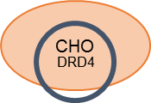
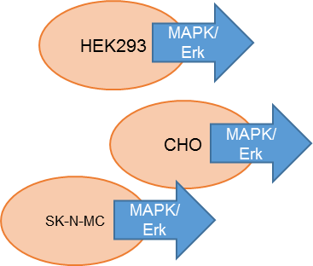
HEK293
cAMP/PKA
Studying GPCR function
Cell line
Receptor
Pathway
Ligand
CHO
cAMP/PKA
SK-N-MC
cAMP/PKA
Endogenous expression
Cell phenotype
Species
Polymorphism
(Dimerization)
Which one(s)?
How to measure?
Stimulating vs inhibitory
HEK293
OPRM1
SK-N-MC
OPRM1
CHO
OPRM1
HEK293
OPRM1
DRD4
cAMP/PKA
CHO
CRHR2
MAPK/Erk
SK-N-MC

Slide 4
POLYMORPHISM
Identify human genes
Identify/map polymorphism
POLYMORPHISM
Identify orthologs
Identify/map polymorphism
Rhesus
Identify signatures of selection in humans
Divergence based only
Divergence compared to polymorphism
Selection in other species
Divergence only
Compared to rhesus polymorphism
Human polymorphism compared to rhesus polymorphism
DIVERGENCE
Evolutionary parameters

Slide 5
Species tree
Orthologs
Duplication
Gene trees
Inter-specific
Intra-specific
Paralogs
1
2A
2B
3A
3B
4A
4B
Species 1
Species 2
Species 3
Species 4

Slide 6
Species tree
Duplication
Gene trees
x
x
1
2A
3B
4A
4B
Species 1
Species 2
Species 3
Species 4

Slide 7
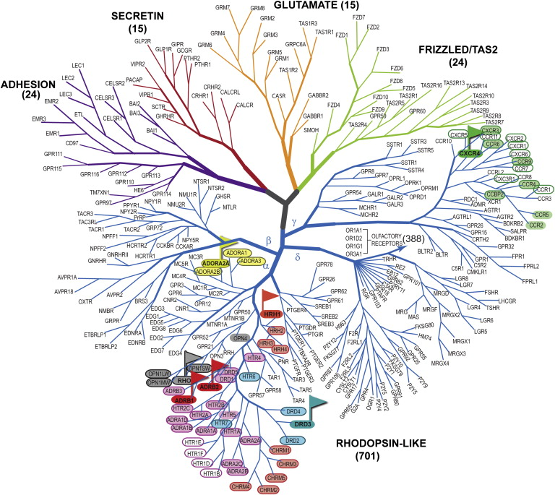

G-Protein Coupled Receptors (GPCRs)
Approximately 800 functional GPCRs (400 olfactory) in human
An additional 600+ olfactory pseudogenes
Kufareva et al., 2011

Slide 8
Distribution of SNPs across the receptors

Slide 9
Macaque SNPs Compared to Humans
 |  |  |  |  | Human |  | Macaque
Gene | AA Position | AA1 | AA2 | Consensus Prediction | dbSNP | Human MAF | Chinese MAF | Indian MAF | Fascicularis MAF
FZD6 | 664 | A | E | Deleterious | rs12549394 | 2% | - | - | 10%
GPR19 | 116 | V | I | Likely Deleterious | rs41276680 | 1% | 2% | - | 22%
GPR44 | 204 | V | A | Likely Neutral | rs2467642 | 1% | 7% | 2% | 17%
GPR78 | 342 | R | H | Deleterious | rs9685931 | 11% | 5% | - | -
GPR98 | 194 | P | H | Deleterious | rs61745498 | 2% | - | 5% | -
GPR146 | 266 | V | M | Deleterious | rs55677825 | 1% | 14% | - | -
GPR153 | 209 | R | H | Neutral | rs12735670 | 31% | 10% | - | -
GPR156 | 798 | R | H | Likely Neutral | rs115365859 | 1% | - | - | 14%
MRGPRX3 | 198 | L | R | Likely Deleterious | rs28482781 | 2% | 7% | - | -
 |  | Human |  |  |  |  | Macaque
Gene | AA Position | AA1 | AA2 | Consensus Prediction | dbSNP | Human MAF | AA1 | AA2 | Consensus Prediction | Chinese MAF | Indian MAF | Fascicularis MAF
DRD5 | 330 | P | Q | Likely Neutral | rs1800762 | 3% | P | L | Neutral | 12% | - | -
GPR78 | 318 | R | C | Likely Neutral | rs61746144 | 1% | R | H | Neutral | - | - | 17%
HTR1E | 208 | A | T | Likely Deleterious | rs3828741 | 1% | A | S | Likely Neutral | - | 3% | -
MRGPRX1 | 55 | R | L | Deleterious | rs55954376 | 1% | R | C | Deleterious | - | 24% | -
P2RY4 | 168 | V | M | Likely Neutral | rs1152186 | 5% | V | A | Likely Neutral | 7% | - | -

Slide 10
Macaque SNPs Compared to Humans
Gene | Domain | Human | Human MAF |  | Macaque | Chinese MAF | Indian MAF | Fascicularis MAF
DRD2 | IC3 | S311C | 2% |  | S259Y | - | 4% | -
 |  |  |  |  | E280D | - | 2% | 4%
 |  |  |  |  | S286I | - | 3% | -
DRD4 | nterm | G11R | 3% |  | A32V | 6% | - | -
DRD4 | TM5 | V194G | 1% |  | F197L | - | 2% | 2%
DRD4 | IC3 | A281P | 23% |  | R233L | 5% | - | -
 |  | S284G | 21% |  | R233G | - | - | 22%
 |  | A335G | 1% |  | P250L | - | 54% | 2%
 |  | W387G | 1% |  | P257R | 7% | - | -
 |  | VNTR |  |  | P258L | 7% | - | 2%
 |  |  |  |  | A291E | 14% | - | -
 |  |  |  |  | G297R | - | - | 11%
 |  |  |  |  | N302D | 6% | - | -
 |  |  |  |  | P305S | - | 57% | 2%
 |  |  |  |  | N318K | 21% | 9% | -
DRD5 | EC3 | P330Q | 3% |  | H325N | - | 3% | -
 |  |  |  |  | E327Q | 5% | 9% | -
 |  |  |  |  | P330L | 12% | - | -
HTR1A | nterm | P16L | 1% |  | P15S | - | - | 100%
 |  |  |  |  | G22S | - | - | 100%
 |  |  |  |  | T32S | - | - | 20%
HTR1A | IC3 | G273D | 1% |  | A328D | - | 1% | 100%
HTR1D | IC3 | S265L | 1% |  | R238P | - | 3% | -
 |  |  |  |  | A285V | 2% | 3% | -
HTR1E | IC3 | A208T | 1% |  | A208S | - | 3% | -
 |  |  |  |  | A234T | - | 3% | -
 |  |  |  |  | T284N | - | 3% | -
HTR2A | nterm | T25N | 1% |  | L11F | - | 4% | -
 |  |  |  |  | S29G | - | 2% | 85%
 |  |  |  |  | N33H | 5% | - | -
 |  |  |  |  | D48E | - | 60% | -
HTR2B | cterm | M421V | 2% |  | K414N | - | - | 3%
 |  |  |  |  | E423D | - | 4% | -
 |  |  |  |  | N424K | - | 4% | -
 |  |  |  |  | S425T | - | 4% | -
 |  |  |  |  | R447T | - | - | 45%
OPRM1 | nterm | A6V | 7% |  | P26R | - | 34% | -
 |  | N40D | 19% |  | G29A | 5% | 33% | -
 |  |  |  |  | P47L | - | - | 31%

Slide 11
Polymorphism on GPCRs
Human
HapMap only so far
Expand to 1000 Genomes
Rhesus
44 Indian, 20 Chinese, 32 cyno
Additional 133 whole genomes available from Rogers et al.
Bacchus (others here, TNPRC)
Mapped to “old” genome, new genome available
Better modeling of putative effects
Grouped comparisons only
Expand to divergence on GPCRs
Compare divergence to polymorphism (à la OPRM1)
Develop informatics pipelines to expand beyond GPCRs

Slide 12
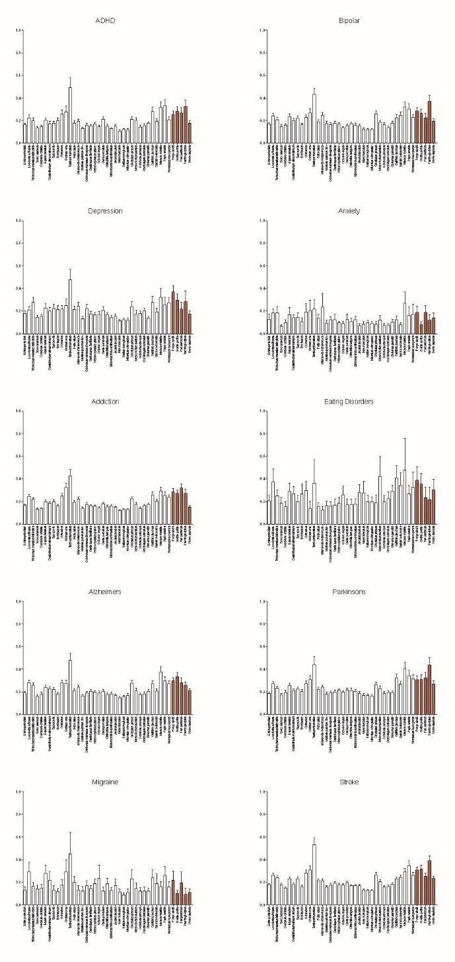
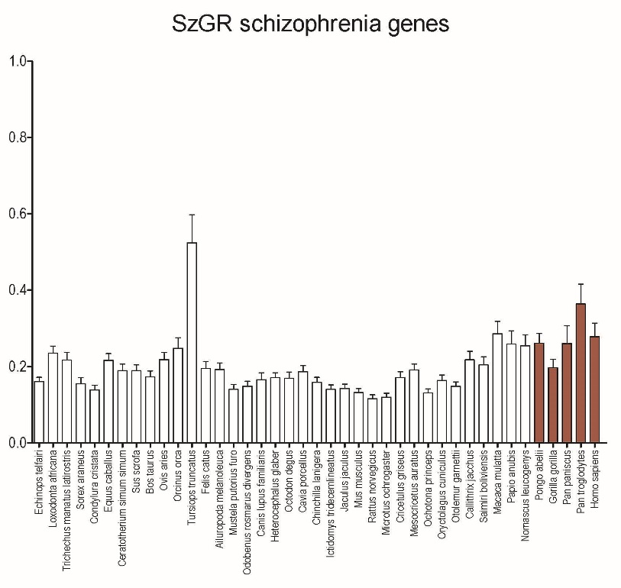
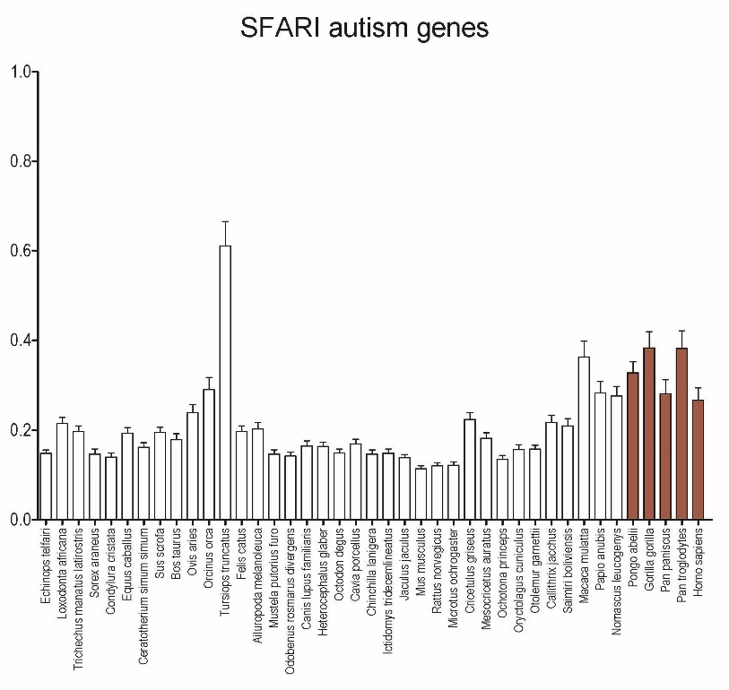
Divergence in Psychiatric Disease

Slide 13
Organisms (42)
Scientific Name | Common Name |  | Scientific Name | Common Name
Homo sapiens | human |  | Monodelphis domestica | gray short-tailed opossum
Macaca mulatta | Rhesus monkey |  | Mus musculus | house mouse
Ailuropoda melanoleuca | giant panda |  | Mustela putorius furo | domestic ferret
Bos taurus | cattle |  | Nomascus leucogenys | northern white-cheeked gibbon
Callithrix jacchus | white-tufted-ear marmoset |  | Ochotona princeps | American pika
Canis lupus familiaris | dog |  | Octodon degus | degu
Cavia porcellus | domestic guinea pig |  | Odobenus rosmarus divergens | Pacific walrus
Ceratotherium simum simum | southern white rhinoceros |  | Orcinus orca | killer whale
Chinchilla lanigera | long-tailed chinchilla |  | Ornithorhynchus anatinus | platypus
Condylura cristata | star-nosed mole |  | Oryctolagus cuniculus | rabbit
Cricetulus griseus | Chinese hamster |  | Otolemur garnettii | small-eared galago
Dasypus novemcinctus | nine-banded armadillo |  | Ovis aries | sheep
Echinops telfairi | small Madagascar hedgehog |  | Pan troglodytes | chimpanzee
Equus caballus | horse |  | Papio anubis | olive baboon
Felis catus | domestic cat |  | Pongo abelii | Sumatran orangutan
Gorilla gorilla gorilla | western lowland gorilla |  | Rattus norvegicus | Norway rat
Heterocephalus glaber | naked mole-rat |  | Saimiri boliviensis boliviensis | Bolivian squirrel monkey
Ictidomys tridecemlineatus | thirteen-lined ground squirrel |  | Sarcophilus harrisii | Tasmanian devil
Jaculus jaculus | lesser Egyptian jerboa |  | Sorex araneus | European shrew
Loxodonta africana | African savanna elephant |  | Sus scrofa | pig
Mesocricetus auratus | golden hamster |  | Trichechus manatus latirostris | Florida manatee
Microtus ochrogaster | prairie vole |  | Tursiops truncatus | bottlenosed dolphin

Slide 15
Identifying orthologs
Run BLAST with each human accession against each species database
Create BLAST databases locally or interface online w/ NCBI
Create file with list of human accessions
Parse output to identify best hit and save accession to file

Slide 16


Tools
BLAST (Basic Local Alignment Search Tool) – Allows us to search for different sequences. This tool gives us tons of control over search parameters.
There is a web version of this tool, but there are also python scripts.
For the python scripts we have several choices:
What machine will be processing the code? Local desktop or Ole Miss supercomputer?
What database will be used? Local BLAST (personal machine) or remote BLAST (NCBI web servers)?
OR

Slide 17
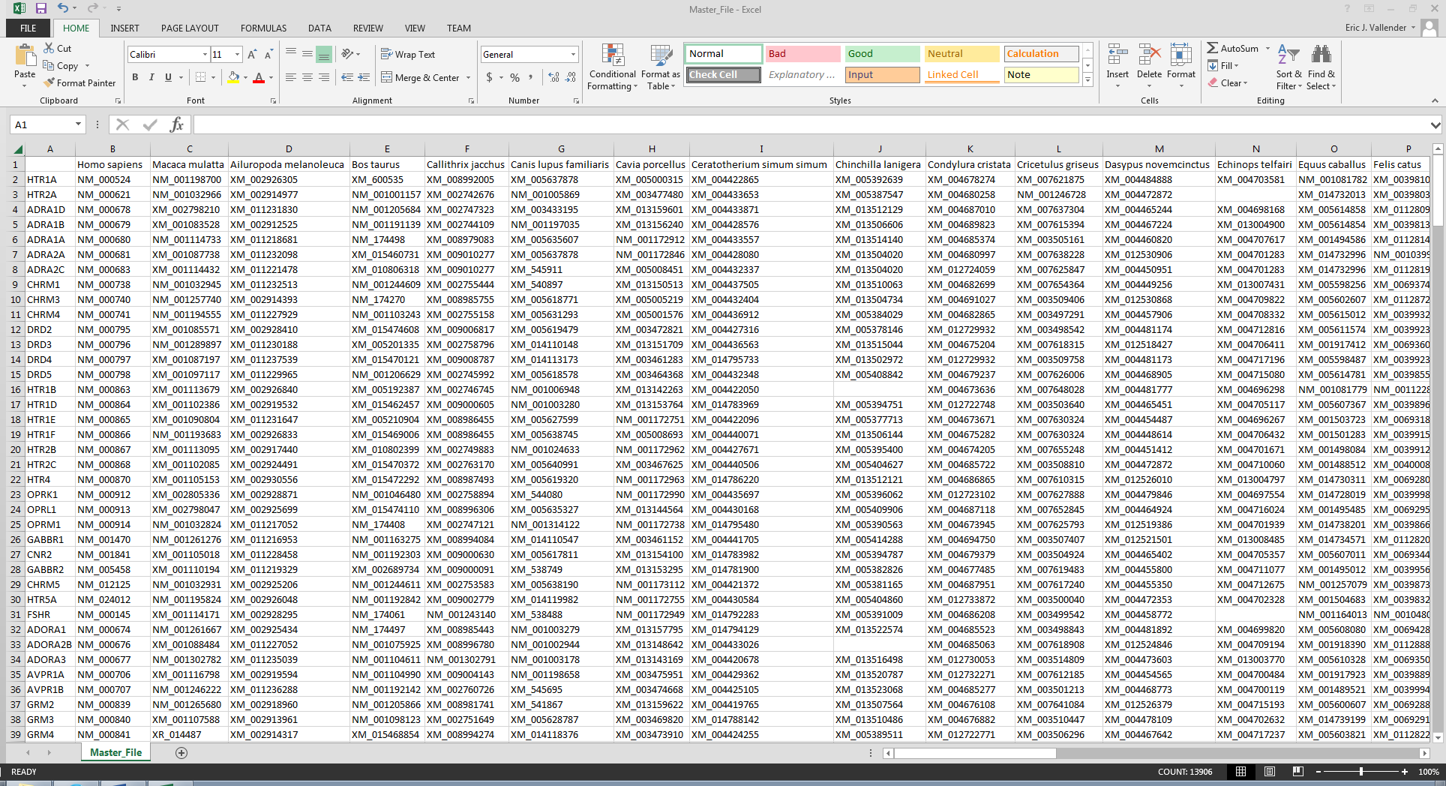

Slide 19
Aligning orthologs and measuring divergence
Align protein sequences (using ClustalW)
Translate to protein sequence
Download coding sequences for all genes and orthologs
Align individual nucleotide sequences to protein sequences (in frame)
Parse PAML output
Run PAML (Phylogenetic Analysis by Maximum Likelihood)
Generate PAML control file(s) and guide tree

Slide 20
Analysis
Analyzing Multiple Sequence Alignment (MSA) data
Phylogenetic data to be analyzed
Synonymous vs Non-synonymous mutations
Ka/Ks ratio provides information about the selective pressure for particular genetic mutations and whether or not they are evolving under positive selection (Darwinian selection) and are therefore advantageous.
This information helps us identify orthologs who’s sequence has undergone positive selection.
By identifying these regions of positive selection, we can further narrow down areas of likely functional relevance, which could be candidates for various cellular and molecular applications. When targeting well studied proteins such as GPCR’s, we can improve the efficacy of our future research.
Target Areas include: CDS (coding), Intracellular and extracellular loops, N-terminus and IC2 (ligand bonding), C-terminus and IC3 (signaling), etc.
After identifying relevant inter-species sequences, we continue with intra-species polymorphism studies to ascertain how different genotypes of these sequences affect the organism (human/rhesus)

Slide 21
Polymorphism (whole genome sequencing)
Rogers paper on population genetics of rhesus macaques submitted
Whole genome sequencing on 133 rhesus
14 rhesus from NEPRC
19 rhesus from TNPRC
Bacchus
17x coverage
TNPRC | Coverage
TU-102 | 30X
TU-103 | 30X
TU-104 | 30X
TU-106 | 30X
TU-109 | 30X
TU-110 | 30X
TU-111 | 30X
TU-112 | 30X
TU-113 | 30X
TU-114 | 30X
TU-133 | 6X
TU-145 | 6X
TU-154 | 6X
TU-159 | 6X
TU-161 | 6X
TU-195 | 6X
TU-121 | 6X
TU-140 | 6X
TU-157 | 6X
NEPRC | Coverage | New location
292-2000 | 6x | Yerkes
508-1999 | 6x | Yerkes
279-2002 | 6x | Southwest
236-1997 | 6x | Yerkes
287-2002 | 6x | Wisconsin
390-2001 | 6x | Yerkes
170-2003 | 30x | Southwest
206-2003 | 30x | Southwest
80-2005 | 30x | Oregon
232-1999 | 30x | Yerkes
376-2000 | 30x | Southwest
235-1997 | 30x | Oregon
58-2002 | 30x | Yerkes
130-1999 | 30x | Yerkes

Slide 22
Polymorphism (GPCRs)
44 Indian, 20 Chinese, 32 cyno
148-1996
177-1996
171-1998
165-2001
318-2001
143-2003
17-2010
18-2010
19-2010
21-2010
22-2010
23-2010
24-2010
25-2010
26-2010
27-2010
28-2010
29-2010
Donna’s Animals
98-1989 | Gallo |  | 107-2009
162-1997 | Blakey |  | 118-2009
247-1997 | Rudy |  | 119-2009
428-1997 | Elvin |  | 121-2009
488-1998 | Gus |  | 128-2009
491-1998 | Spacey |  | 132-2009
267-1999 | Louis |  | 388-2010
125-2002 | Farley |  | 389-2010
271-2002 | Soleil |  | 400-2010
372-2003 | Spade |  | 407-2010
374-2003 | Rooster |  | 408-2010
33-2007 | Mourinho |  | 409-2010
James’ “Diabetes” Animals
Unknowns
228-1994
492-1999

Slide 23
Genome Browser
Rhesus SNP Database
NM_001032966
HTR2A
(Chr17)

Slide 24
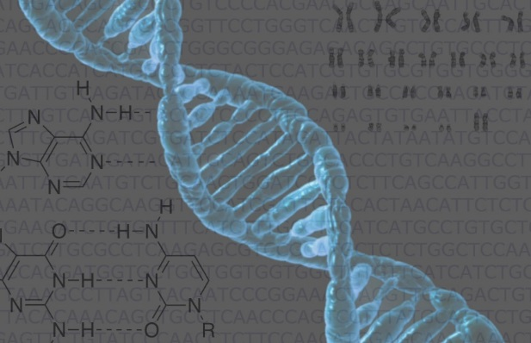
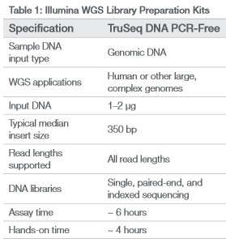
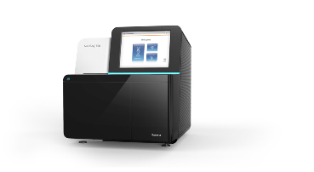
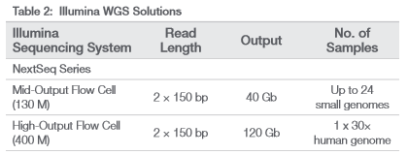
Genomics and Bioinformatics
Blood Draw
DNA Isolation
Library Construction
Sequencing
Reference Genome
Read Mapping
BWA
BAM Creation
Picard
Variant Calling
SNPTool
GATK
Variant Annotation
SnpEff
VEP
dbscSNV
FATHMM-MKL
CADD
Molecular and Genomics Core Facility
Mississippi Center
for Supercomputing Research

